Slide 1

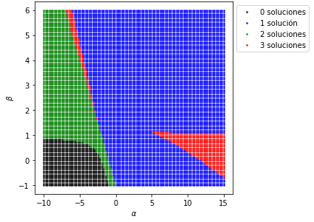
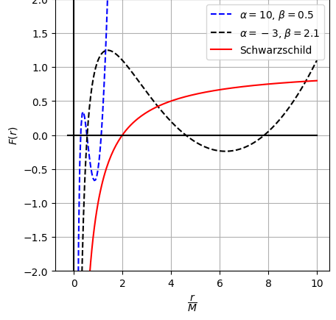
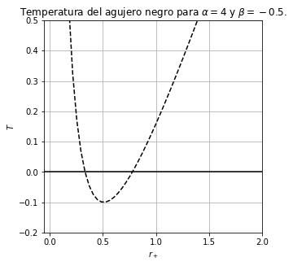
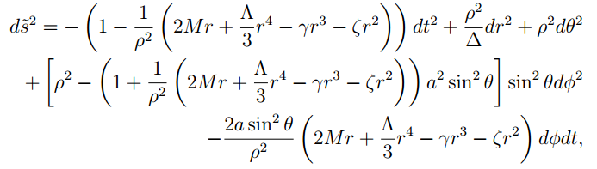

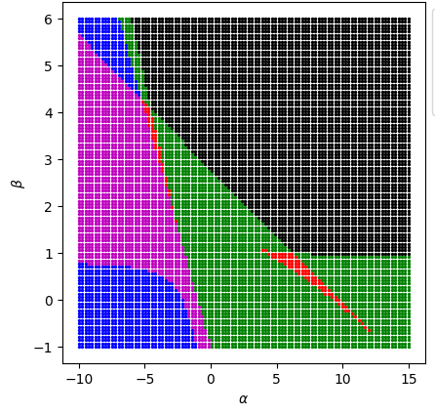
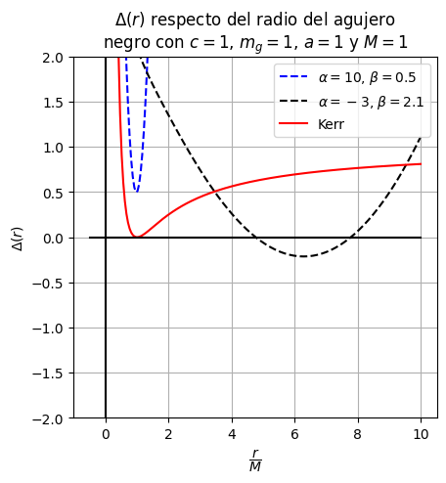
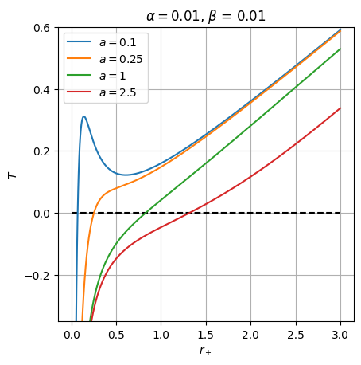

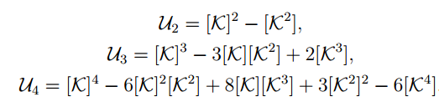



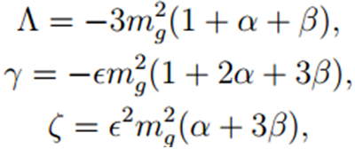
Rotating black hole in dRGT massive gravity
Author jmorenotr@unal.edu.co
Director ealarranaga@unal.edu.co
Astronomía, astrofísica y cosmología
Programa de Pregrado en Física
Abstract
The following work is a result from the study of massive gravity proposed by Claudia de Rham, Gregory Gabadadze and Andrew Tolley, a theory that is an alternative to the general relativity, and two possible types of black holes. The first black hole is obtained from the theory's field equations and corresponds to a static ( Schwarzschild-type) line element. The second black hole is a proposal of a rotating black hole in the massive gravity theory obtained by using the well known Janis-Newman algorithm.
For both solutions were studied the event horizon and its behavior, the surface gravity, the temperature and the entropy; for the static black hole was obtained the essential singularity, while for the rotating black hole was obtained the ergosphere and the dragging of inertial frames, aspects that are not present in the static solution.
Introduction
The general relativity (GR) is the main theory of gravity for its results and predictions [1]. Even with the effectiveness of GR, there are many other alternatives that can describe the gravity and some other open problems in GR. One of the alternatives is the massive gravity theory proposed by Claudia de Rham, Gregory Gabadadze and Andrew Tolley (dRGT), in this theory the graviton (particle of the gravity field) is massive. The massive gravity theories were interesting because they give us an explanation for the cosmologic constant problem. Study the field equations of dRGT massive gravity is important to try to understand this GR alternative.
Figure 1: Event horizon and temperture behavior of static black hole solution [3].
In figure 1 can see the behavior of event horizon and the temperature. First, the static solution has maximum of 3 event horizons, this depend on different combinations of parameters. In the thermodynamic properties, was found that the temperature present a minimum value and present the evaporation problem of a Schwarzschild black hole.
Methodology
At first was introduced the necessity to use massive gravity and why to use the dRGT massive gravity over another theory. Then, was studied the dRGT massive gravity, the differences between GR and its field equations. After was obtained, directly from field equations, a static solution in the theory, then was studied the event horizon and the thermodynamic behavior, all the results were compared with the results reported in [2]. Finally, from the static solution was applied the well known Janis-Newman algorithm to get a rotating black hole for the dRGT theory that was not reported yet and then was studied the event horizon, the ergosphere, the dragging of inertial frames and its thermodynamic properties.
3. Rotating Black Hole
After obtaining the static solution the Janis-Newman algorithm was applied over it, obtaining the following solution
Results
1. dRGT Massive Gravity
An action to get a generic and covariant theory of massive gravity is obtained by adding a potential to the Einstein-Hilbert action, the potential proposed in dRGT massive gravity is
where,
Using the Stationary-action principle should obtain the field equations of the dRGT theory, this field equations can be written as
where,
and
Figure 2 shows the behavior of the event horizon and the temperature of the rotating black hole. It was found that the rotating black hole presents maximum of 4 event horizon, and the spin parameter of the black hole makes relevant conform makes bigger. In the temperature, this black hole did not present the evaporation problem and at some point will gets freeze.
Figure 2: Event horizon and temperture behavior of rotating black hole [3].
Conclusion
In this work was summarized the dRGT theory and described the differences between GR and other massive gravity theories, understanding the applicability. Then, was deduced a static solution, showed at subsection 2, and was described the behavior of the horizon and thermodynamics of the black hole. Finally, in section 3 was obtained, after applying the Janis-Newman algorithm, a new rotating black hole and was studied its horizon, ergosphere, and thermodynamics. In all this process learned about investigating and massive gravity as was planned at the beginning.
2. Static Black Hole
Once the field equations were obtained, can be proposed an ansatz that can be written as
replacing the ansatz solution on the field equations the function unknown function F would be known. This function is
where,
References
Claudia de Rham. Massive gravity. LIVING REVIEWS IN RELATIVITY, 17, 2014.
Suchant G. Ghosh, Lunchakorn Tannukij, and Pitayuth Wongjun. A class of black holes in dRGT massive gravity and their thermodynamical properties. The Eropean, Physical Journal C, 76(3), mar 2016.
Moreno J. AgujerosNegrosdRGT, 9 2022. https://github.com/Jh0mpis/AgujerosNegrosdRGT.

